Slide 1
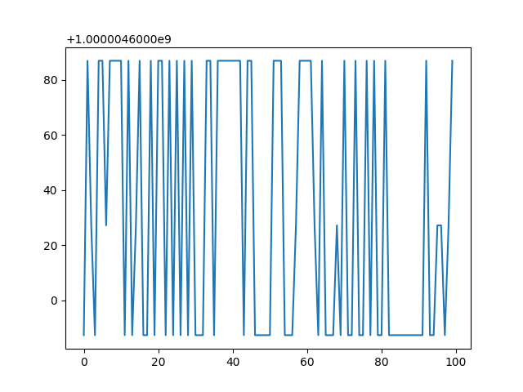
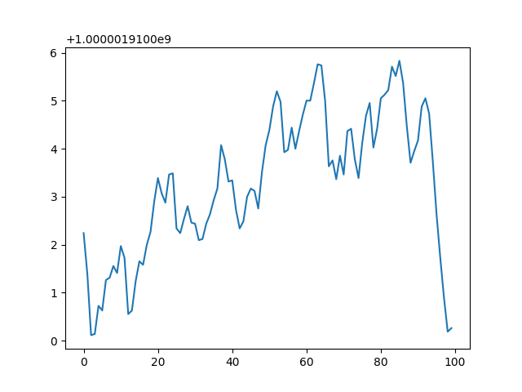

Slide 2
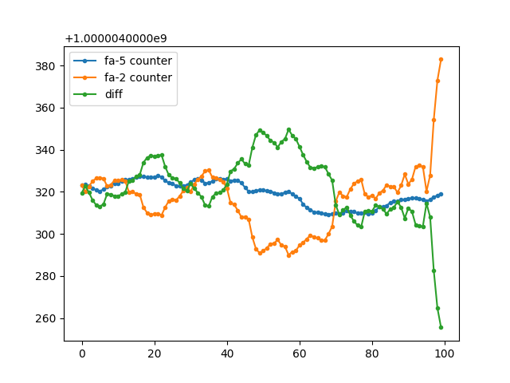
Green vs Black Counter

Slide 3
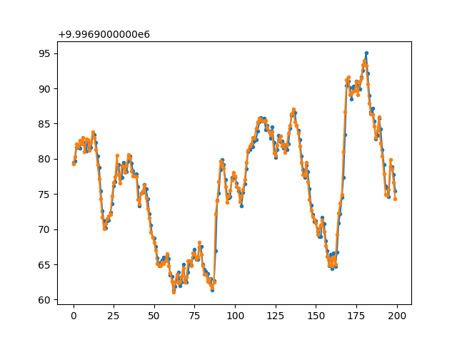
Two channels of the Agilent Compared (same input signal)

Slide 4
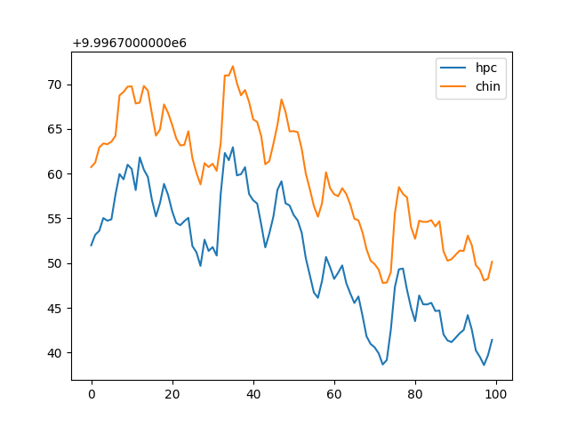
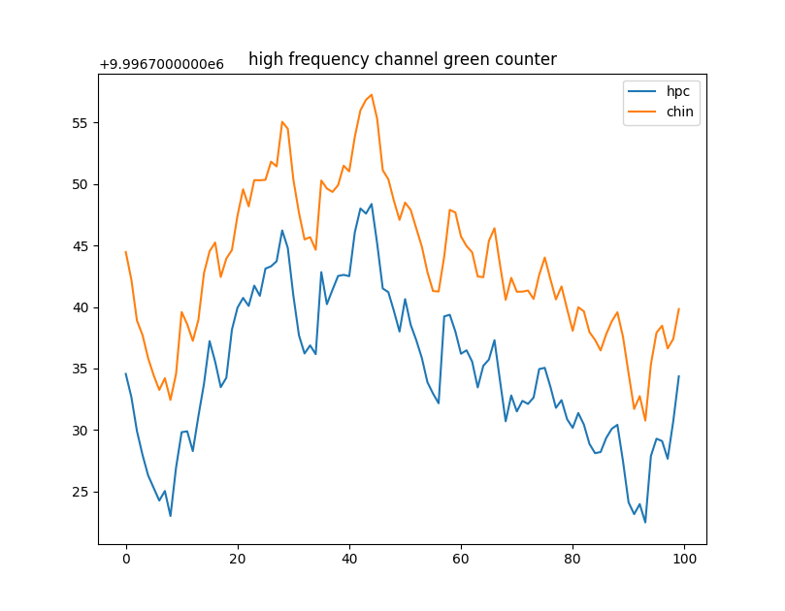
Low frequency channel green counter

Slide 5
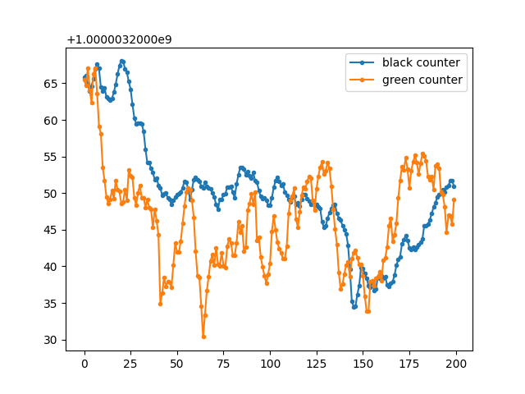
Collecting data closer together (sequential lines in the code)
Subsequently, it turned out the black one couldn’t take data on the low-frequency channel, altogether we’ve had inconsistent performance with the black frequency counter and will return it, the green one hasn’t given us trouble so far.

Slide 6
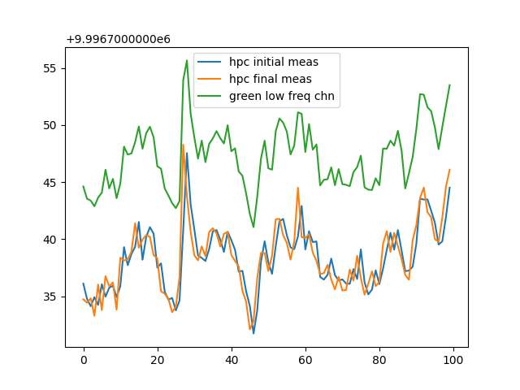

Slide 7
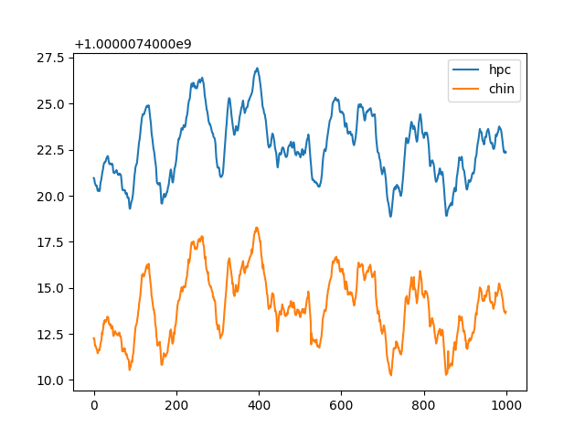
Use the green counter 1 GHz channel, and a mixed down signal for one channel of the Agilent:
Average offset is:
8.678 Hz
Agilent reading is an average of measurements taken before and after the green counter measures

